Slide 1
Method Madness
An overview of population genomic methods for non-model organisms
BIO 594

Slide 2
It’s not a bracket!
EecSeq
RADseq
EecSeq
RNAseq
RNAseq
EecSeq
PoolSeq
lcWGS
lcWGS
lcWGS
Target Capture

Slide 3
It’s not a bracket!

Slide 4
Population Genomics for non-model organisms
Aim of Study | Optimal sequencing method
Population subdivision, migration rates, population size changes through time | RAD
Genes under selection | Exome Sequencing
Selection signatures and genomic regions underlying ecological speciation | Low-coverage WGS PoolSeq (less optimal)
Molecular basis of acclimatization, adaptation | RNAseq or TagSeq
Genome-wide DNA methylation and Epigenetic inference | MBD-Seq, MethylRAD, EpiRAD
Adapted from Matz 2018

Slide 5
Population Genomics for non-model organisms
Aim of Study | Optimal sequencing method | Minimal Reference Needed
Population subdivision, migration rates, population size changes through time | RAD | None
Genes under selection | Exome Sequencing | De novo transcriptome Soon to be none with EecSeq
Selection signatures and genomic regions underlying ecological speciation | Low-coverage WGS PoolSeq (less optimal) | Draft genome
Molecular basis of acclimatization, adaptation | RNAseq or TagSeq | None or De novo transcriptome
Genome-wide DNA methylation and Epigenetic inference | MBD-Seq, MethylRAD, EpiRAD | None for the two RAD approaches, otherwise de novo transcriptome
Adapted from Matz 2018

Slide 6
Population Genomics for non-model organisms
Aim of Study | Optimal sequencing method | Minimal Reference Needed
Population subdivision, migration rates, population size changes through time | RAD | None
Genes under selection | Exome Sequencing | De novo transcriptome Soon to be none with EecSeq
Selection signatures and genomic regions underlying ecological speciation | Low-coverage WGS PoolSeq (less optimal) | Draft genome
Molecular basis of acclimatization, adaptation | RNAseq or TagSeq | None or De novo transcriptome
Genome-wide DNA methylation and Epigenetic inference | MBD-Seq, MethylRAD, EpiRAD | None for the two RAD approaches, otherwise de novo transcriptome
Adapted from Matz 2018

Slide 7
Population Genomics for non-model organisms
Aim of Study | Optimal sequencing method | Minimal Reference Needed
Population subdivision, migration rates, population size changes through time | RAD | None
Genes under selection | Exome Sequencing | De novo transcriptome Soon to be none with EecSeq
Selection signatures and genomic regions underlying ecological speciation | Low-coverage WGS PoolSeq (less optimal) | Draft genome
Molecular basis of acclimatization, adaptation | RNAseq or TagSeq | None or De novo transcriptome
Genome-wide DNA methylation and Epigenetic inference | MBD-Seq, MethylRAD, EpiRAD | None for the two RAD approaches, otherwise de novo transcriptome
Adapted from Matz 2018

Slide 8

The basics
Gene
Exon
Intron
mRNA
Protein

Slide 9
RNAseq
RNAseq focuses on sequencing RNA directly
Gene
Exon
Intron
RNA
Protein

Slide 10
RNAseq
RNAseq focuses on sequencing RNA directly
RNA

Slide 11
RNAseq
RNAseq focuses on sequencing RNA directly
RNA

Slide 12
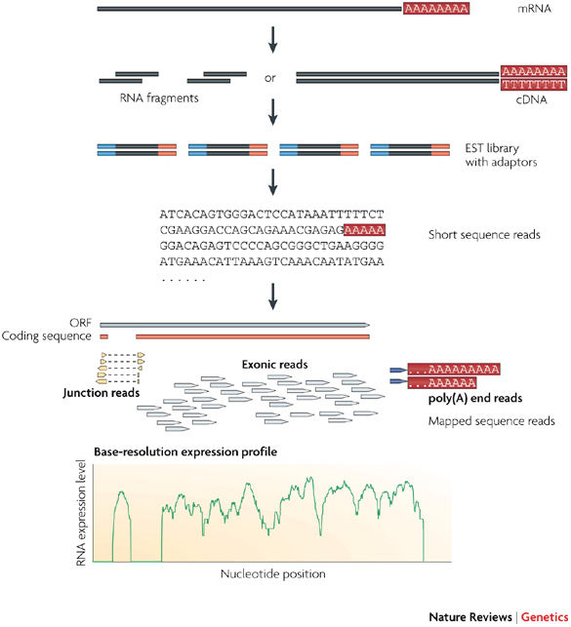
RNAseq
RNAseq focuses on sequencing RNA directly
Identify transcripts and quantify gene expression
Obtain “transcriptome”: snapshot of expression of all genes a time point
Conesa et al., 2016; Wang et al., 2009

Slide 13
Exome vs genome

Slide 14
Exome vs genome

Slide 15
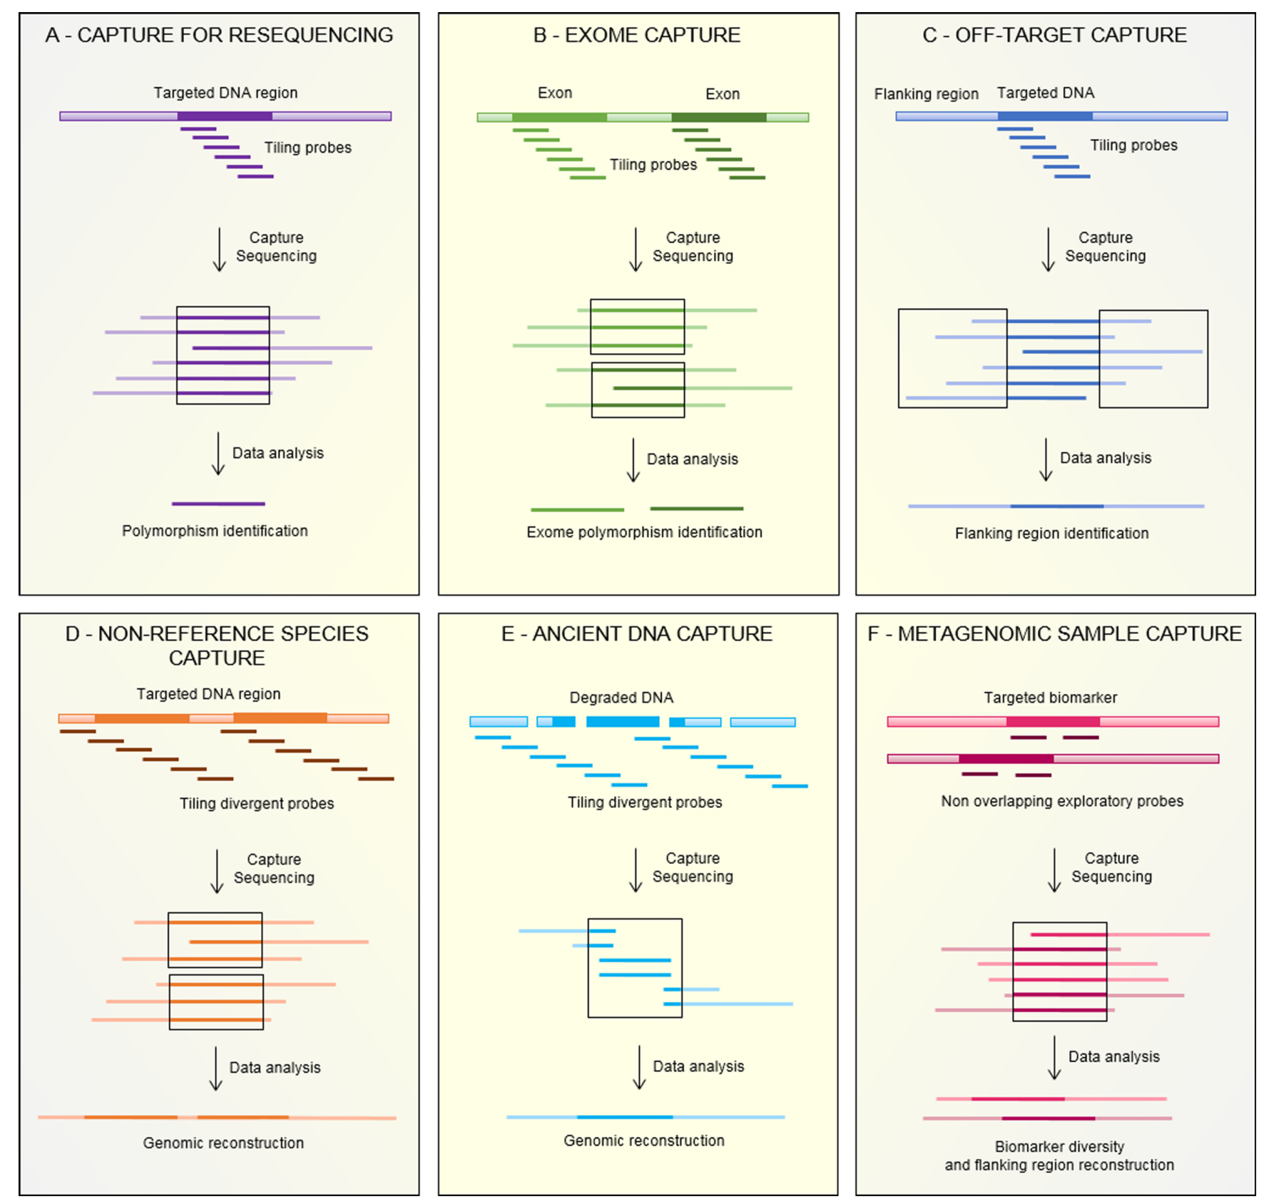
Exome capture
BIO 594

Slide 16
Exome capture
Exome capture focuses sequencing on the portions of the genome that lead to changes in protein function
BIO 594

Slide 17
The exome: the ultimate genome reduction
RADseq
Cheap
May not sample target genes

Slide 18
The exome: the ultimate genome reduction
RADseq
Cheap
May not sample target genes
RNAseq
Relatively expensive

Slide 19
The exome: the ultimate genome reduction
RADseq
Cheap
May not sample target genes
RNAseq
Relatively expensive

Slide 20
The exome: the ultimate genome reduction
RADseq
Cheap
May not sample target genes
RNAseq
Relatively expensive
Allele specific expression

Slide 21
The exome: the ultimate genome reduction
RADseq
Cheap
May not sample target genes
RNAseq
Relatively expensive
Allele specific expression

Slide 22
The exome: the ultimate genome reduction
RADseq
Cheap
May not sample target genes
RNAseq
Relatively expensive
Allele specific expression
Exome capture
Requires an annotated transcriptome, preferably genome
Requires synthesized probes

Slide 23
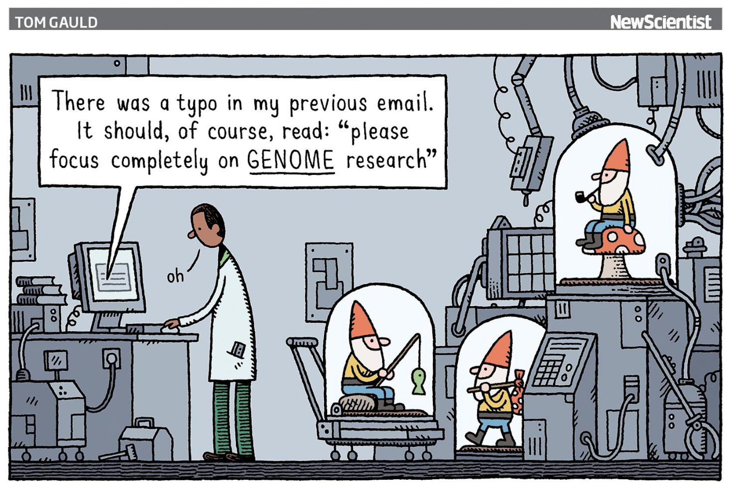
Population genomics without genome reduction
Forget individuals
Estimate allele frequencies from populations directly
PoolSeq
Forget genotypes
Drastically reduce the coverage per individual and work directly with genotype likelihoods
lcWGS
BIO 594

Slide 24
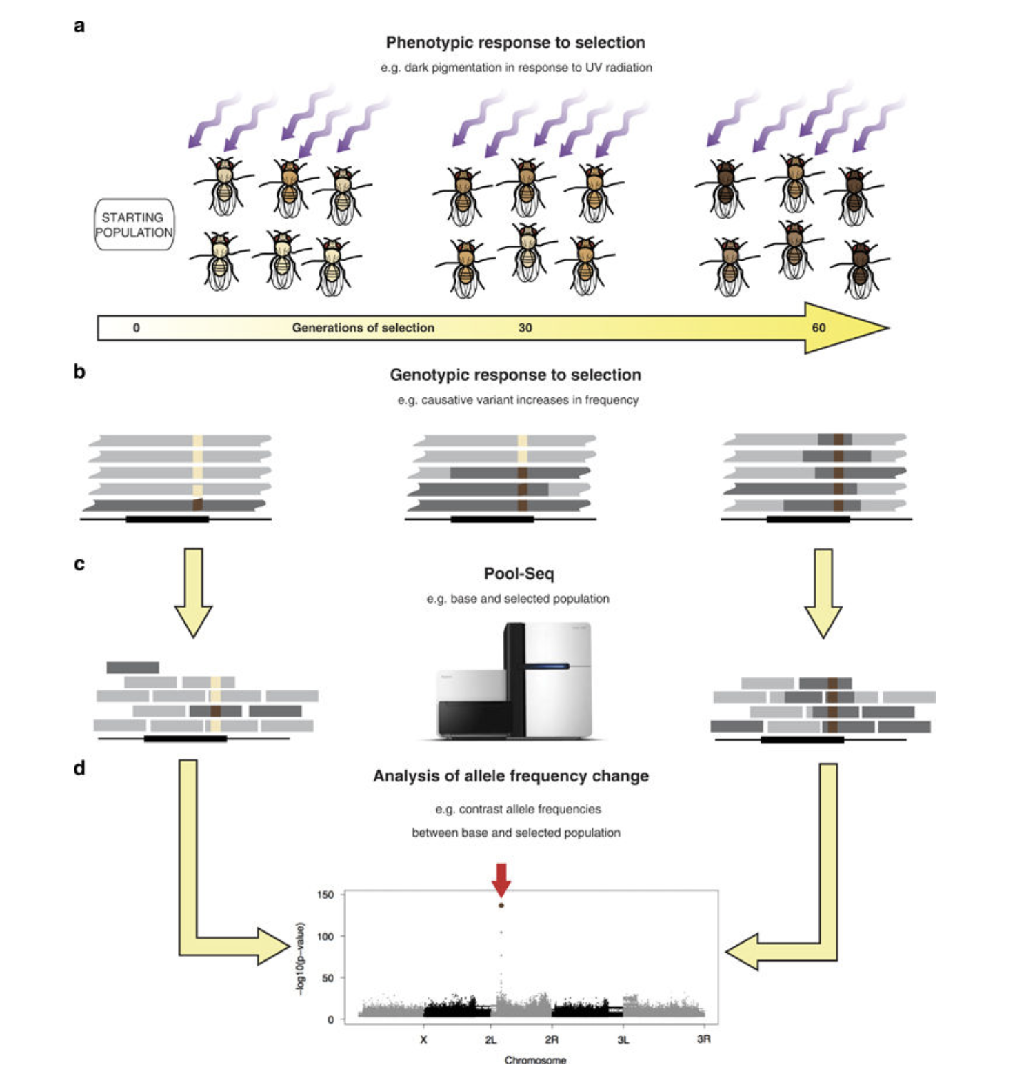
Pooled Sequencing
PoolSeq
DNA/RNA are equimollarly pooled within a population/treatment
Read counts are directly used or placed into a model to estimate the allele frequency of the pool
BIO 594

Slide 25
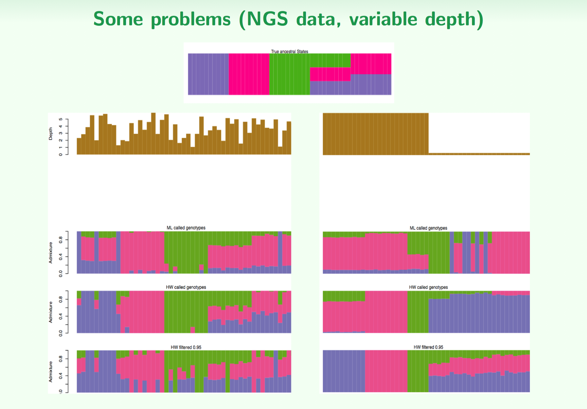
Population genomics with lcWGS
BIO 594

Slide 26
lcWGS: remove genotypes from the equation
AATTCACCTCGGGTATCTTCAGGAAAACGGTCAAAATCAGGTTTCACAGTATATTGGACTCCTC
AATTCACCTCGGGTATCTTCAGGAAAACGGTCAAAATCAGGTTTCACAGTATATTGGACTCCTC
AATTCACCTCGGGTATCTTCAGGAAAACGGTCAAAATCAGGTTTCACAGTATATTGGACTCCTC
AATTCACCTCGGGTATCTTCAGGAAAACGGTCAAAATCAGGTTTCACAGTATATTGGACTCCTC
AATTCACCTCGGGTATCTTCAGGAAAACGGTCAAAATCAGGTTTCACAGTATATTGGACTCCTC
AATTCACCTCGGGTATCTTCAGGAAAACAGTCAAAATCAGGTTTCACAGTATATTGGACTCCTC
AATTCACCTCGGGTATCTTCAGGAAAACAGTCAAAATCAGGTTTCACAGTATATTGGACTCCTC
AATTCACCTCGGGTATCTTCAGGAAAACAGTCAAAATCAGGTTTCACAGTATATTGGACTCCTC
AATTCACCTCGGGTATCTTCAGGAAAACAGTCAAAATCAGGTTTCACAGTATATTGGACTCCTC
AATTCACCTCGGGTATCTTCAGGAAAACAGTCAAAATCAGGTTTCACAGTATATTGGACTCCTC
BIO 594

Slide 27
lcWGS: remove genotypes from the equation
AATTCACCTCGGGTATCTTCAGGAAAACGGTCAAAATCAGGTTTCACAGTATATTGGACTCCTC
AATTCACCTCGGGTATCTTCAGGAAAACGGTCAAAATCAGGTTTCACAGTATATTGGACTCCTC
AATTCACCTCGGGTATCTTCAGGAAAACGGTCAAAATCAGGTTTCACAGTATATTGGACTCCTC
AATTCACCTCGGGTATCTTCAGGAAAACGGTCAAAATCAGGTTTCACAGTATATTGGACTCCTC
AATTCACCTCGGGTATCTTCAGGAAAACGGTCAAAATCAGGTTTCACAGTATATTGGACTCCTC
AATTCACCTCGGGTATCTTCAGGAAAACAGTCAAAATCAGGTTTCACAGTATATTGGACTCCTC
AATTCACCTCGGGTATCTTCAGGAAAACAGTCAAAATCAGGTTTCACAGTATATTGGACTCCTC
AATTCACCTCGGGTATCTTCAGGAAAACAGTCAAAATCAGGTTTCACAGTATATTGGACTCCTC
AATTCACCTCGGGTATCTTCAGGAAAACAGTCAAAATCAGGTTTCACAGTATATTGGACTCCTC
AATTCACCTCGGGTATCTTCAGGAAAACAGTCAAAATCAGGTTTCACAGTATATTGGACTCCTC
Likelihood of this individual being a G/A heterozygote?
Likelihood of this individual being a G/G homozygote?
Likelihood of this individual being a A/A homozygote?
BIO 594

Slide 28
lcWGS: remove genotypes from the equation
AATTCACCTCGGGTATCTTCAGGAAAACGGTCAAAATCAGGTTTCACAGTATATTGGACTCCTC
AATTCACCTCGGGTATCTTCAGGAAAACGGTCAAAATCAGGTTTCACAGTATATTGGACTCCTC
AATTCACCTCGGGTATCTTCAGGAAAACGGTCAAAATCAGGTTTCACAGTATATTGGACTCCTC
AATTCACCTCGGGTATCTTCAGGAAAACGGTCAAAATCAGGTTTCACAGTATATTGGACTCCTC
AATTCACCTCGGGTATCTTCAGGAAAACGGTCAAAATCAGGTTTCACAGTATATTGGACTCCTC
AATTCACCTCGGGTATCTTCAGGAAAACGGTCAAAATCAGGTTTCACAGTATATTGGACTCCTC
AATTCACCTCGGGTATCTTCAGGAAAACGGTCAAAATCAGGTTTCACAGTATATTGGACTCCTC
AATTCACCTCGGGTATCTTCAGGAAAACGGTCAAAATCAGGTTTCACAGTATATTGGACTCCTC
AATTCACCTCGGGTATCTTCAGGAAAACGGTCAAAATCAGGTTTCACAGTATATTGGACTCCTC
AATTCACCTCGGGTATCTTCAGGAAAACGGTCAAAATCAGGTTTCACAGTATATTGGACTCCTC
Likelihood of this individual being a G/A heterozygote?
Likelihood of this individual being a G/G homozygote?
Likelihood of this individual being a A/A homozygote?
BIO 594

Slide 29
lcWGS: remove genotypes from the equation
AATTCACCTCGGGTATCTTCAGGAAAACAGTCAAAATCAGGTTTCACAGTATATTGGACTCCTC
AATTCACCTCGGGTATCTTCAGGAAAACAGTCAAAATCAGGTTTCACAGTATATTGGACTCCTC
AATTCACCTCGGGTATCTTCAGGAAAACAGTCAAAATCAGGTTTCACAGTATATTGGACTCCTC
AATTCACCTCGGGTATCTTCAGGAAAACAGTCAAAATCAGGTTTCACAGTATATTGGACTCCTC
AATTCACCTCGGGTATCTTCAGGAAAACAGTCAAAATCAGGTTTCACAGTATATTGGACTCCTC
AATTCACCTCGGGTATCTTCAGGAAAACAGTCAAAATCAGGTTTCACAGTATATTGGACTCCTC
AATTCACCTCGGGTATCTTCAGGAAAACAGTCAAAATCAGGTTTCACAGTATATTGGACTCCTC
AATTCACCTCGGGTATCTTCAGGAAAACAGTCAAAATCAGGTTTCACAGTATATTGGACTCCTC
AATTCACCTCGGGTATCTTCAGGAAAACAGTCAAAATCAGGTTTCACAGTATATTGGACTCCTC
AATTCACCTCGGGTATCTTCAGGAAAACAGTCAAAATCAGGTTTCACAGTATATTGGACTCCTC
Likelihood of this individual being a G/A heterozygote?
Likelihood of this individual being a G/G homozygote?
Likelihood of this individual being a A/A homozygote?
BIO 594

Slide 30
lcWGS: remove genotypes from the equation
AATTCACCTCGGGTATCTTCAGGAAAACGGTCAAAATCAGGTTTCACAGTATATTGGACTCCTC
AATTCACCTCGGGTATCTTCAGGAAAACGGTCAAAATCAGGTTTCACAGTATATTGGACTCCTC
AATTCACCTCGGGTATCTTCAGGAAAACGGTCAAAATCAGGTTTCACAGTATATTGGACTCCTC
AATTCACCTCGGGTATCTTCAGGAAAACGGTCAAAATCAGGTTTCACAGTATATTGGACTCCTC
AATTCACCTCGGGTATCTTCAGGAAAACGGTCAAAATCAGGTTTCACAGTATATTGGACTCCTC
AATTCACCTCGGGTATCTTCAGGAAAACGGTCAAAATCAGGTTTCACAGTATATTGGACTCCTC
AATTCACCTCGGGTATCTTCAGGAAAACGGTCAAAATCAGGTTTCACAGTATATTGGACTCCTC
AATTCACCTCGGGTATCTTCAGGAAAACGGTCAAAATCAGGTTTCACAGTATATTGGACTCCTC
AATTCACCTCGGGTATCTTCAGGAAAACAGTCAAAATCAGGTTTCACAGTATATTGGACTCCTC
AATTCACCTCGGGTATCTTCAGGAAAACAGTCAAAATCAGGTTTCACAGTATATTGGACTCCTC
Likelihood of this individual being a G/A heterozygote?
Likelihood of this individual being a G/G homozygote?
Likelihood of this individual being a A/A homozygote?
BIO 594

Slide 31
lcWGS: remove genotypes from the equation
AATTCACCTCGGGTATCTTCAGGAAAACGGTCAAAATCAGGTTTCACAGTATATTGGACTCCTC
AATTCACCTCGGGTATCTTCAGGAAAACGGTCAAAATCAGGTTTCACAGTATATTGGACTCCTC
AATTCACCTCGGGTATCTTCAGGAAAACGGTCAAAATCAGGTTTCACAGTATATTGGACTCCTC
AATTCACCTCGGGTATCTTCAGGAAAACAGTCAAAATCAGGTTTCACAGTATATTGGACTCCTC
AATTCACCTCGGGTATCTTCAGGAAAACAGTCAAAATCAGGTTTCACAGTATATTGGACTCCTC
Likelihood of this individual being a G/A heterozygote?
Likelihood of this individual being a G/G homozygote?
Likelihood of this individual being a A/A homozygote?
BIO 594

Slide 32
lcWGS: remove genotypes from the equation
AATTCACCTCGGGTATCTTCAGGAAAACGGTCAAAATCAGGTTTCACAGTATATTGGACTCCTC
AATTCACCTCGGGTATCTTCAGGAAAACAGTCAAAATCAGGTTTCACAGTATATTGGACTCCTC
Likelihood of this individual being a G/A heterozygote?
Likelihood of this individual being a G/G homozygote?
Likelihood of this individual being a A/A homozygote?
BIO 594

Slide 33
lcWGS: remove genotypes from the equation
Likelihood of this individual being a G/A heterozygote L1
Likelihood of this individual being a G/G homozygote L2
Likelihood of this individual being a A/A homozygote L3
BIO 594

Slide 34
lcWGS: remove genotypes from the equation
Likelihood of this individual being a G/A heterozygote L1
Likelihood of this individual being a G/G homozygote L2
Likelihood of this individual being a A/A homozygote L3
Individual | G/A | G/G | A/A | F(A) | F(G)
IND_01 | L1_01 | L2_01 | L3_01
IND_02 | L1_02 | L2_02 | L3_02
IND_03 | L1_03 | L2_03 | L3_03
IND_04 | L1_04 | L2_04 | L3_04
IND_05 | L1_05 | L2_05 | L3_05
BIO 594

Slide 35
lcWGS: remove genotypes from the equation
Likelihood of this individual being a G/A heterozygote L1
Likelihood of this individual being a G/G homozygote L2
Likelihood of this individual being a A/A homozygote L3
Individual | G/A | G/G | A/A | F(A) | F(G)
IND_01 | L1_01 | L2_01 | L3_01
IND_02 | L1_02 | L2_02 | L3_02
IND_03 | L1_03 | L2_03 | L3_03
IND_04 | L1_04 | L2_04 | L3_04
IND_05 | L1_05 | L2_05 | L3_05
Genotypes likelihoods can the be imputed again from population level allele frequencies
However, this relies on the assumption of HWE!!!!
BIO 594

